Slide 1
Robot Framework

Slide 2
Robot Framework
Robot Framework is an open source test automation framework for acceptance testing and acceptance test-driven development. Test cases are written using keyword style in a tabular format. Robot Framework provides good support for external libraries, tools that are open source and can be used for automation. The most popular library used with Robot Framework is Selenium Library used for web development & UI testing.
Features:
It comes with a simple tabular format where the test cases are written using keywords
It comes with built-in keywords available with robot framework, keywords available from the libraries like Selenium Library (open browser, close browser, maximize browser, etc). We can also create user-defined keywords,
Has support for a lot of external libraries like Selenium library, Database library, FTP library and HTTP library
Allows to tag test-cases so that we can either run the tags test-cases or skip the tagged test cases
Provides all the details of test suite, test case execution in the form of report and logs.

Slide 3
Tools for Robot Framework
Selenium as the automation tool
Python as scripting language
Eclipse as IDE

Slide 4
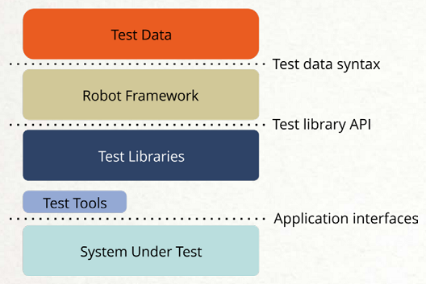
Robot Framework Architecture

Slide 5
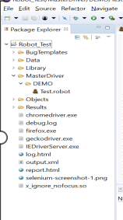
Robot Framework Folder Structure
Parameters are passed from a CSV or excel file under Data
Functions or modules are stored under library folder
Robot file contains the test cases to run
Objects are identified using xpath are stored under objects
Reports generated as part of the framework

Slide 6
Robot Framework
Data:
Each test case will have a separate worksheet with the parameters to be passes based on the functionality.
Library:
Common Library contains the functions used across different modules(Login, Logoff). And each module will have a separate python file with reusable actions.
Objects:
Common Object repository contains the object used for common library functions and each module will have a separate OR file with all objects identified using xpath.
Reports:
Following 3 reports are generated as part of the framework
Log.html
Report.html
Output.xml

Slide 7
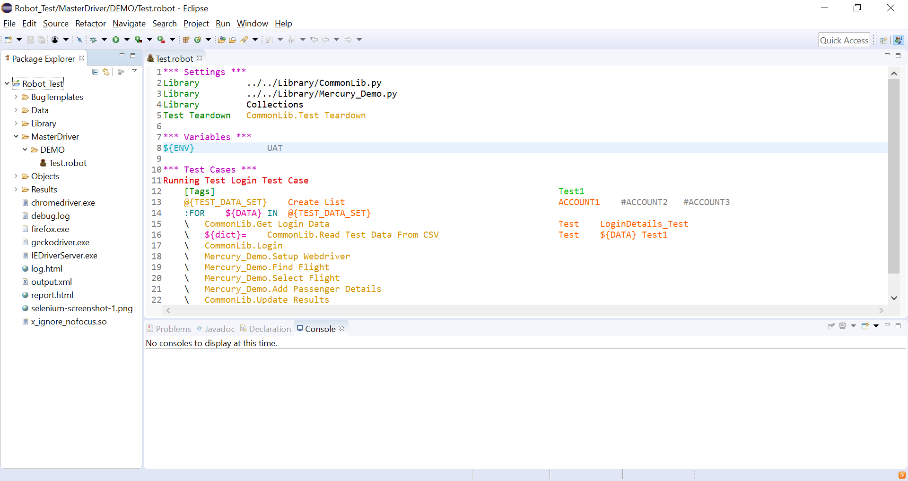
Robot Framework – Master driver

Slide 8
Robot Framework – Master driver
It is the main test suite where tests are created using the function created. When a test is run, it reads the data and searches for the function on corresponding library and executes it. Once it is executed driver runs the test tear down(exit criteria).
Key Features:
Can run the same test for different accounts by creating a dictionary object with all the account details.
Can skip execution for accounts by adding ‘#’ before them.
Has an option to add tags for tests. We can have multiple tags for same tests.
Can run the tests which has specific tag by adding them in the run configurations. It helps us in running the specific tests and skip other tests for a particular release.
Can define the test tear down based on our requirements

Slide 9
Reports
Three output files are created when tests are executed. All output files can be set using an absolute path, in which case they are created to the specified place. The default output directory is the directory where the execution is started from.
Log.html - Log files contain details about the executed test cases in HTML format. They have a hierarchical structure showing test suite, test case and keyword details. Log files are needed nearly every time when test results are to be investigated in detail.
Report.html - Report files contain an overview of the test execution results in HTML format. They have statistics based on tags and executed test suites, as well as a list of all executed test cases. When both reports and logs are generated, the report has links to the log file for easy navigation to more detailed information
Output.xml - XUnit result files contain the test execution summary in compatible XML format. These files can thus be used as an input for external tools that understand xUnit reports. For example, Jenkins continuous integration server supports generating statistics based on xUnit compatible results.

